Slide 1

CHHATTISGARH SWAMI VIVEKANAND TECHNICAL UNIVERSITY , BHILAI PROFESSIONAL ETHICS AND LIFE SKILLS
GUIDED BY : VIVEK GARG
PRESENTED BY : RUCHI SHUKLA
B.TECH HONOURS – ARTIFICIAL INTELLIGENCE (CSE)
ROLLL N0 : 45

Slide 2
SENSE OF SURVIVAL

Slide 3

Definition of sense of survival
Any of the faculties by which the mind receives information about the external world or about the state of the body …
This Photo by Unknown author is licensed under CC BY.

Slide 4


Support and safety
.

Slide 5
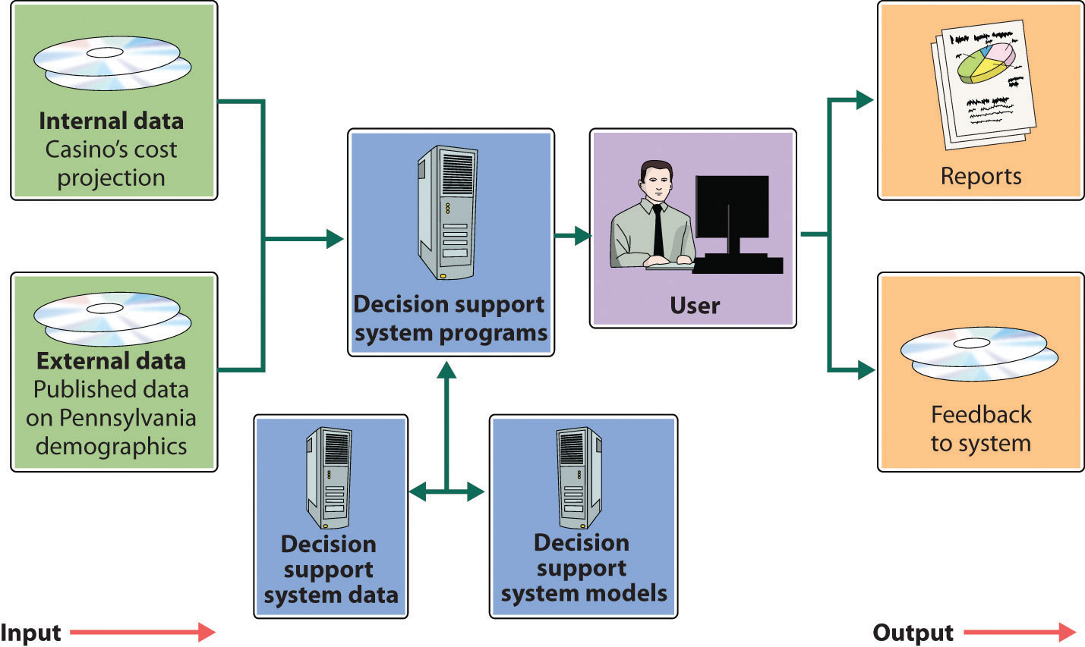
Support
Support is defined as to provide comfort, encouragement or financial assistance to someone. An example of support is listening to a friend in need.
An example of support is lending money to a sibling. Support means to carry, hold up or bear the weight of someone or something.

Slide 6




Slide 7
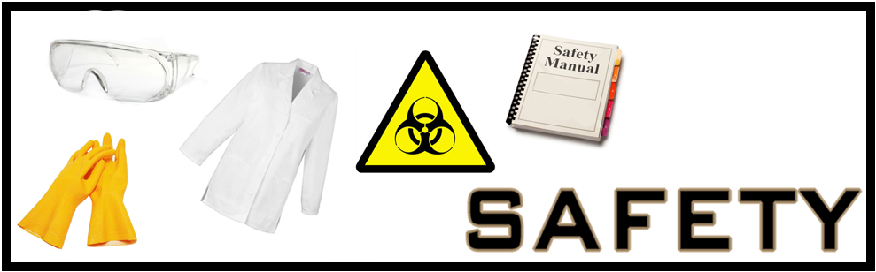
.
Safety is a concept that includes all measures and practices taken to preserve the life, health, and bodily integrity of individuals.
In the workplace, safety is measured through a series of metrics that track the rate of near misses, injuries, illnesses, and fatalities.
In order to improve these metrics, employers and safety officials must also conduct investigations following any incident to ensure that all safety protocols and measures are being followed or to implement new ones if needed.

Slide 8
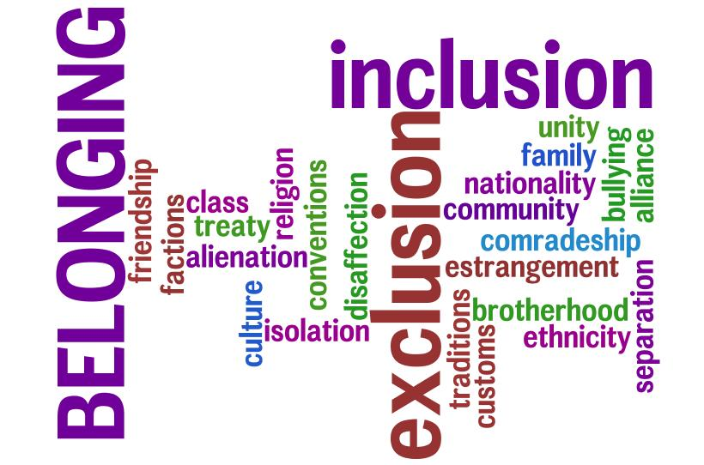

Connection and belonging
This Photo by Unknown author is licensed under CC BY-NC-ND.

Slide 9

Connection
A connection
is a relationship between two things, people, or groups.
Example
The police say he had no connection with the security forces.
He has denied any connection to the bombing.

Slide 10
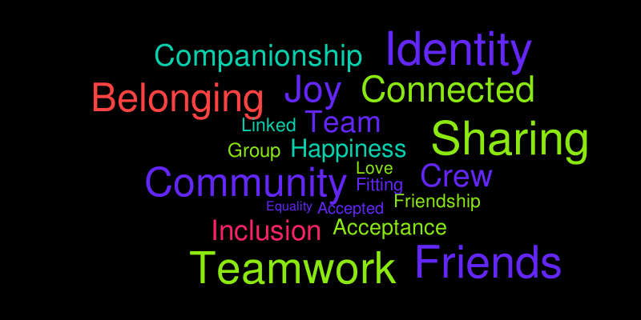
BELONGING
Belonging is a sense of fitting in or feeling like you are an important member of a group. A really close family gives each of its members a strong sense of belonging.
Belongingness, refers to a human emotional need for interpersonal relationships, affiliating, connectedness, and being part of a group.
Examples of belongingness needs include friendship, intimacy, trust, and acceptance, receiving and giving affection, and love.
This Photo by Unknown author is licensed under CC BY-NC-ND.

Slide 11
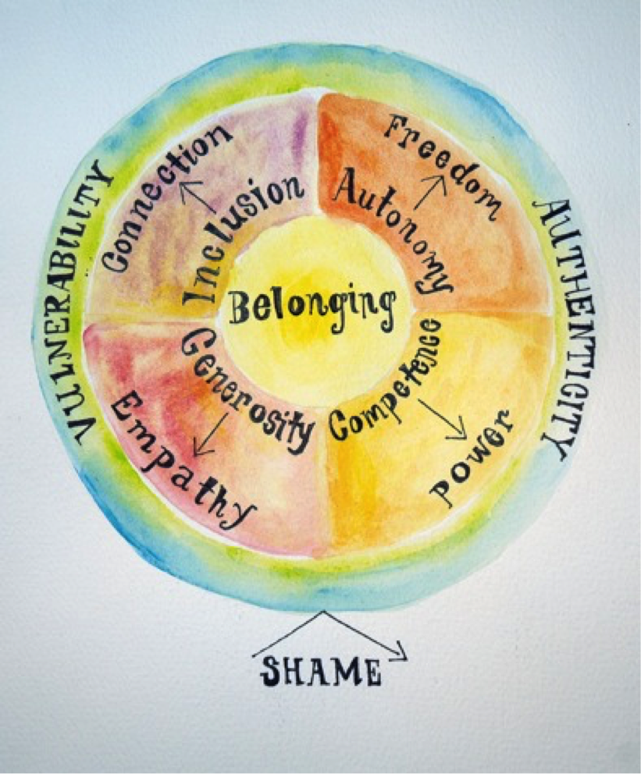

Slide 12
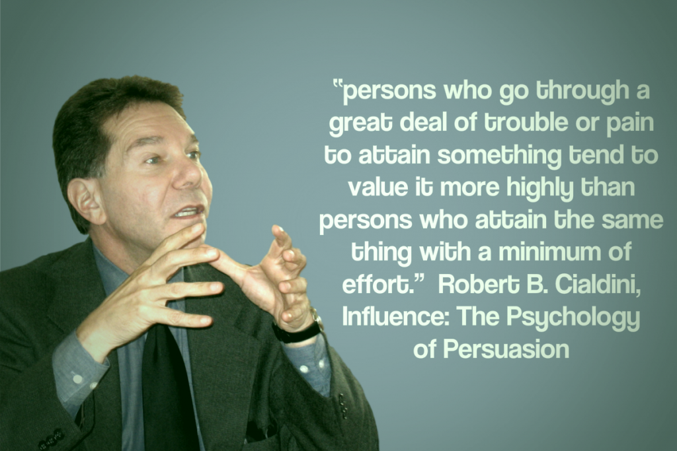
influence

Slide 13
INFLUENCE
The capacity to have an effect on the character, development, or behavior of someone or something, or the effect itself.
Influence is defined as to affect a person or thing.
An example of influence is for a high school student to complete all of his assignments on time, thereby making his little brother want to do the same.
The definition of influence is the power that someone has over someone or something.

Slide 14

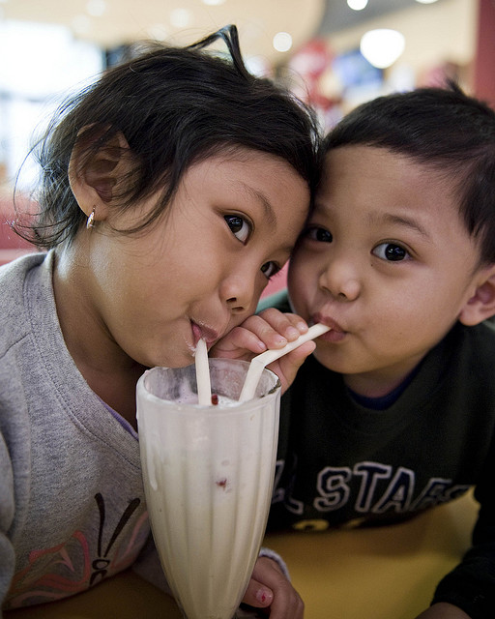

This Photo by Unknown author is licensed under CC BY.
This Photo by Unknown author is licensed under CC BY.
This Photo by Unknown author is licensed under CC BY.
This Photo by Unknown author is licensed under CC BY-SA-NC.

Slide 15
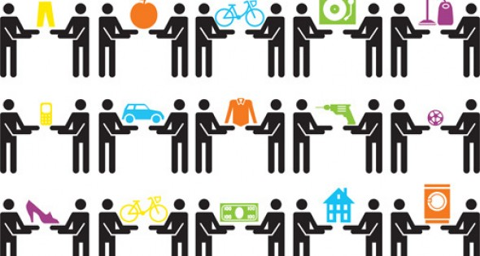

SHARING
Sharing is the joint use of a resource or space. It is also the process of dividing and distributing.
In its narrow sense, it refers to joint or alternating use of inherently finite goods, such as a common pasture or a shared residence.
Still more loosely, "sharing" can actually mean giving something as an outright gift:
for example, to "share" one's food really means to give some of it as a gift. Sharing is a basic component of human interaction, and is responsible for strengthening social ties and ensuring a person’s well-being.
This Photo by Unknown author is licensed under CC BY.

Slide 16

.

Slide 17

LEARNING
Learning is “a process that leads to change, which occurs as a result of experience and increases the potential for improved performance and future learning”
The three basic types of learning styles are visual, auditory, and kinesthetic. To learn, we depend on our senses to process the information around us. Most people tend to use one of their senses more than the others.
An example of learning is a student understanding and remembering what they've been taught.

Slide 18

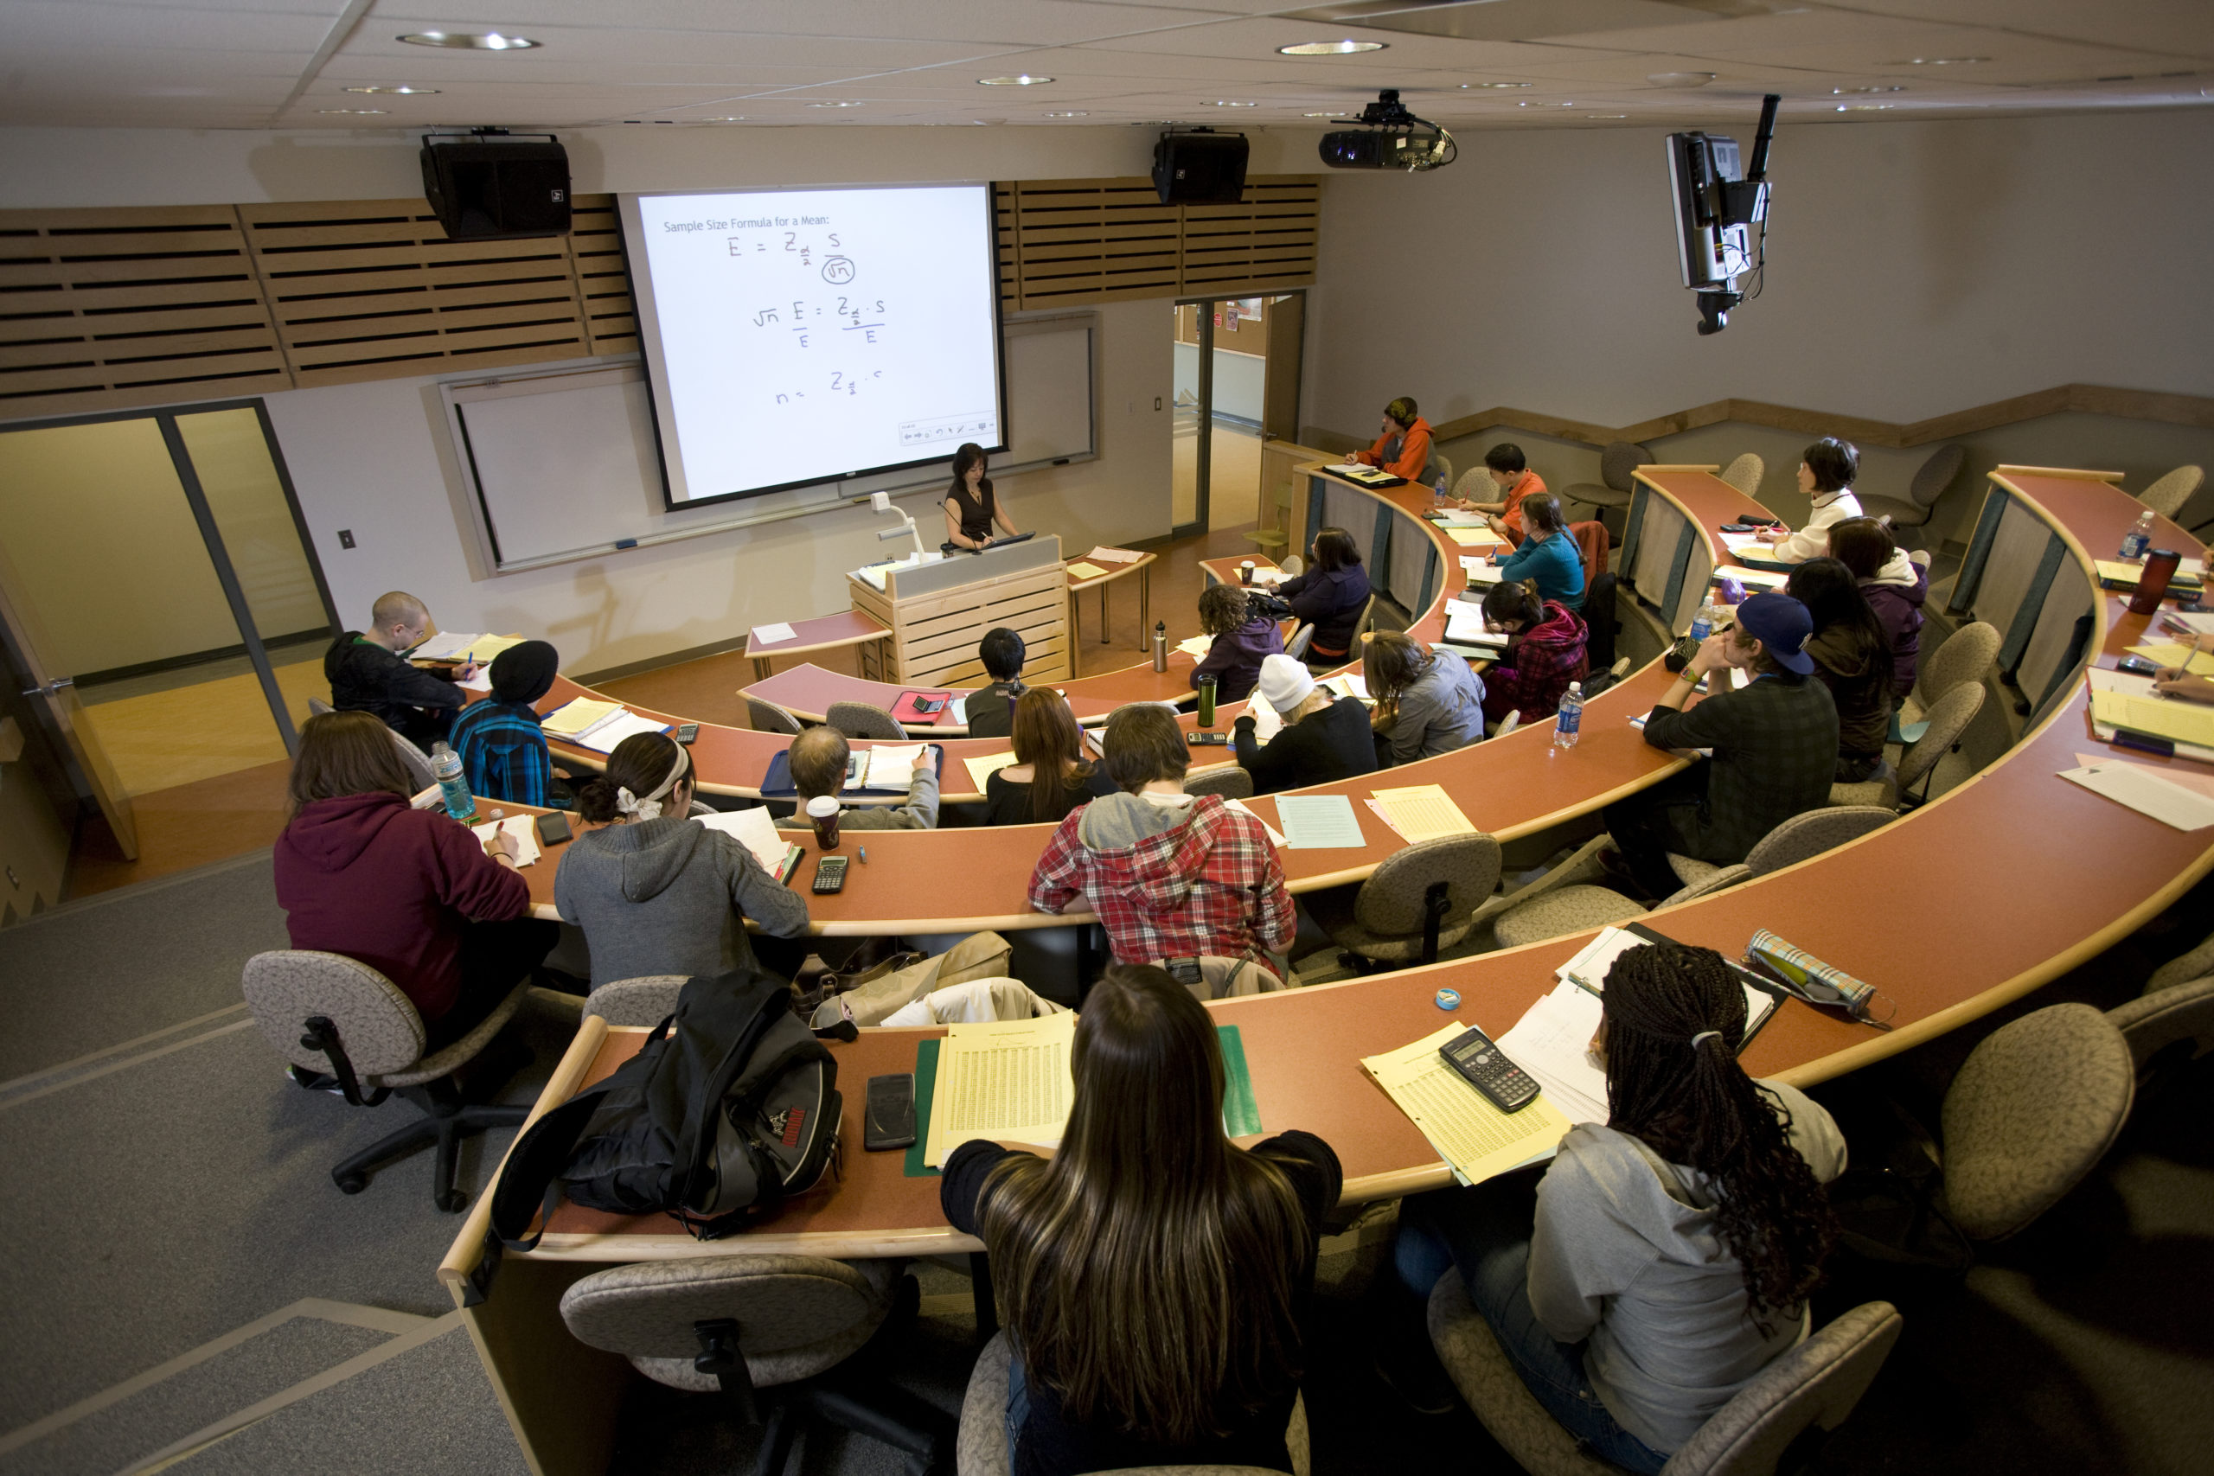

Slide 19
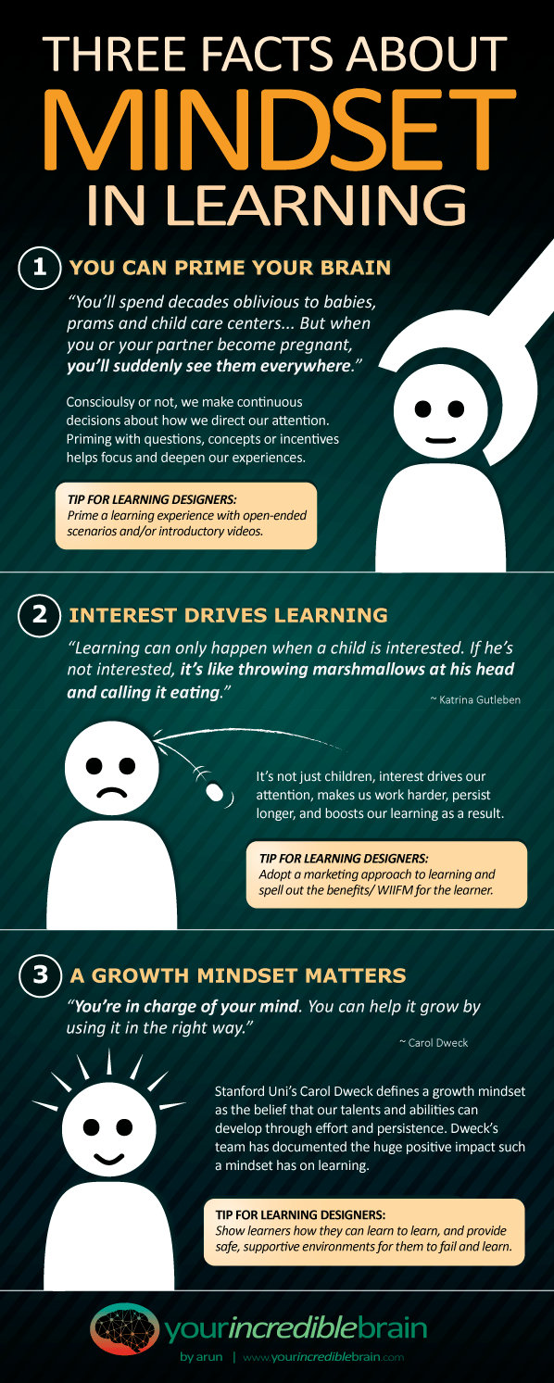

Slide 20


ACCEPTANCE
.

Slide 21

ACCEPTANCE
Acceptance in human psychology is a person's assent to the reality of a situation, recognizing a process or condition (often a negative or uncomfortable situation) without attempting to change it or protest it.
Examples of express acceptance include signing a contract, orally accepting the offer, shaking hands, or even exchanging business cards with the offer and accepted terms

Slide 22
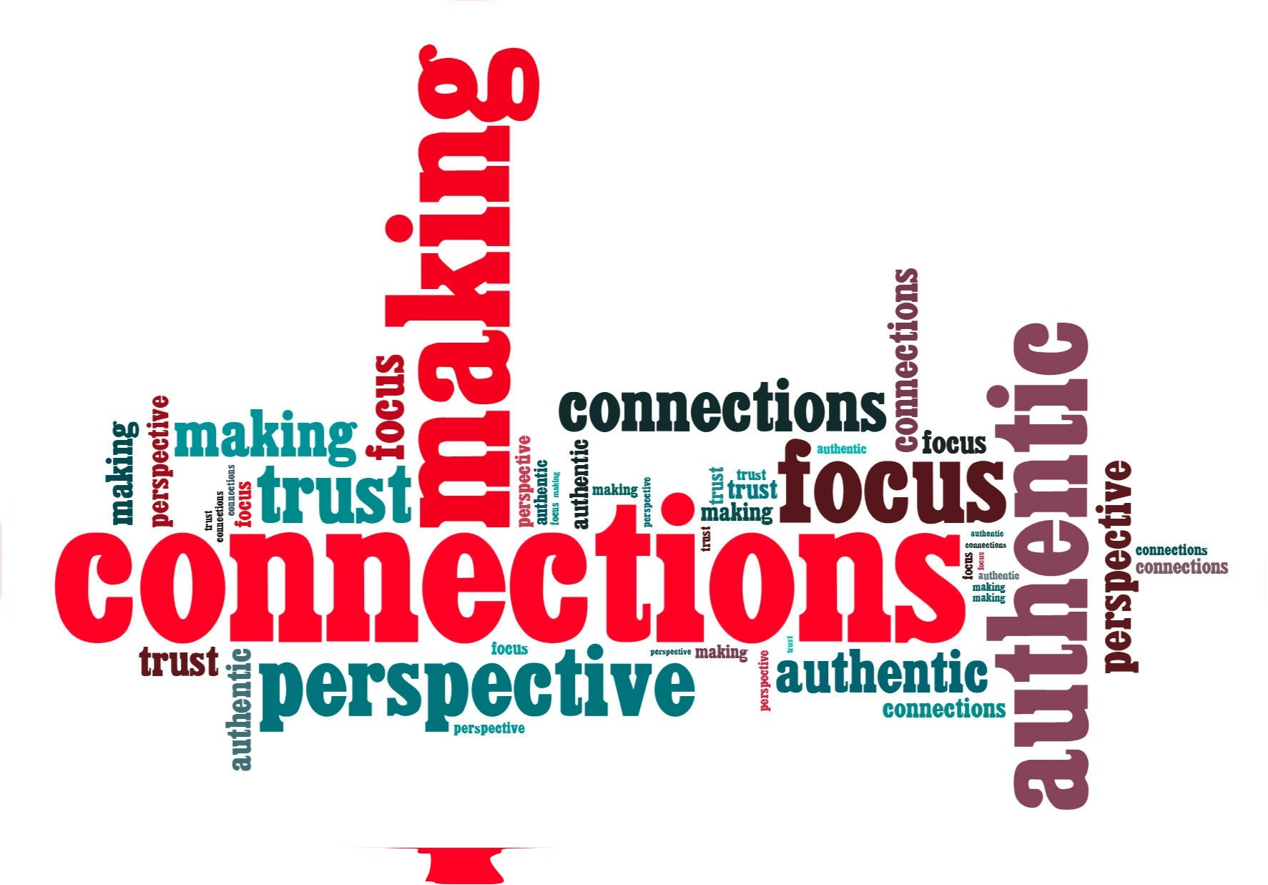
MORE CONNECTIONS MORE CHANCES OF SUCCESS
This Photo by Unknown author is licensed under CC BY-NC-ND.

Slide 23

More connections more chances of success
Experts agree that the most connected people are often the most successful.
When you invest in your relationships — professional and personal — it can pay you back in dividends throughout the course of your career.
Having a strong support system helps people overcome challenges more easily and maintain a state of mental well-being.
Human connection also decreases health risks and improves physical well-being and longevity.
Strong social connections strengthen the immune system and increase your chances of a longer life by 50%.

Slide 24
more connections more chances of success
Why is it important to expand your network?
By continually putting yourself out there and meeting new people, you're effectively stepping outside your comfort zone and building invaluable social skills and self-confidence that you can take with you anywhere. The more you network, the more you'll grow and learn how to make lasting connections
What is effective networking?
Effective networking is all about the people you know and meeting new people through other people. Your network is only as strong as the way you manage it.

Slide 25
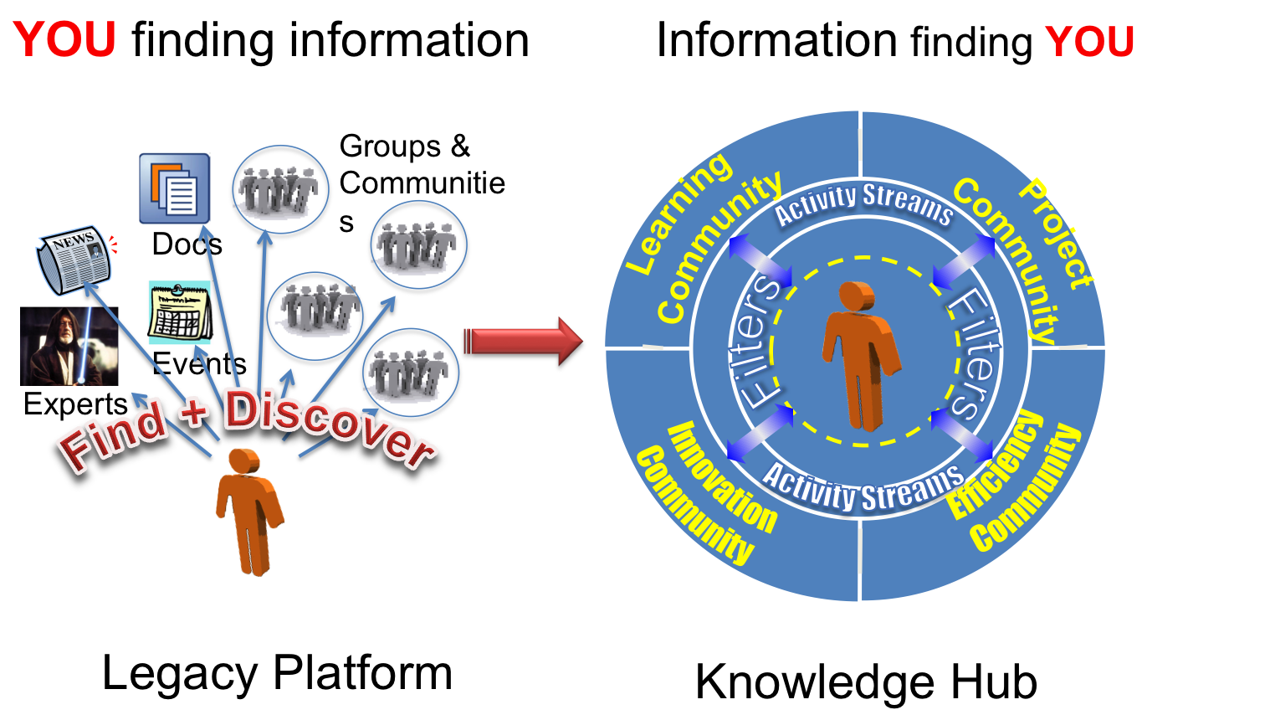
What are four qualities of successful networking?
The 7 Characteristics of a Great Networker
Good listener. Being a good listener tops the list. ...
Positive attitude. The first thing that people see from you is your attitude, how you handle yourself day in and day out. ...
Helps others/collaborative. ...
Sincere/authentic. ...
Follows up. ...
Trustworthy. ...
Approachable.
This Photo by Unknown author is licensed under CC BY-SA-NC.

Slide 26


